Slide 1
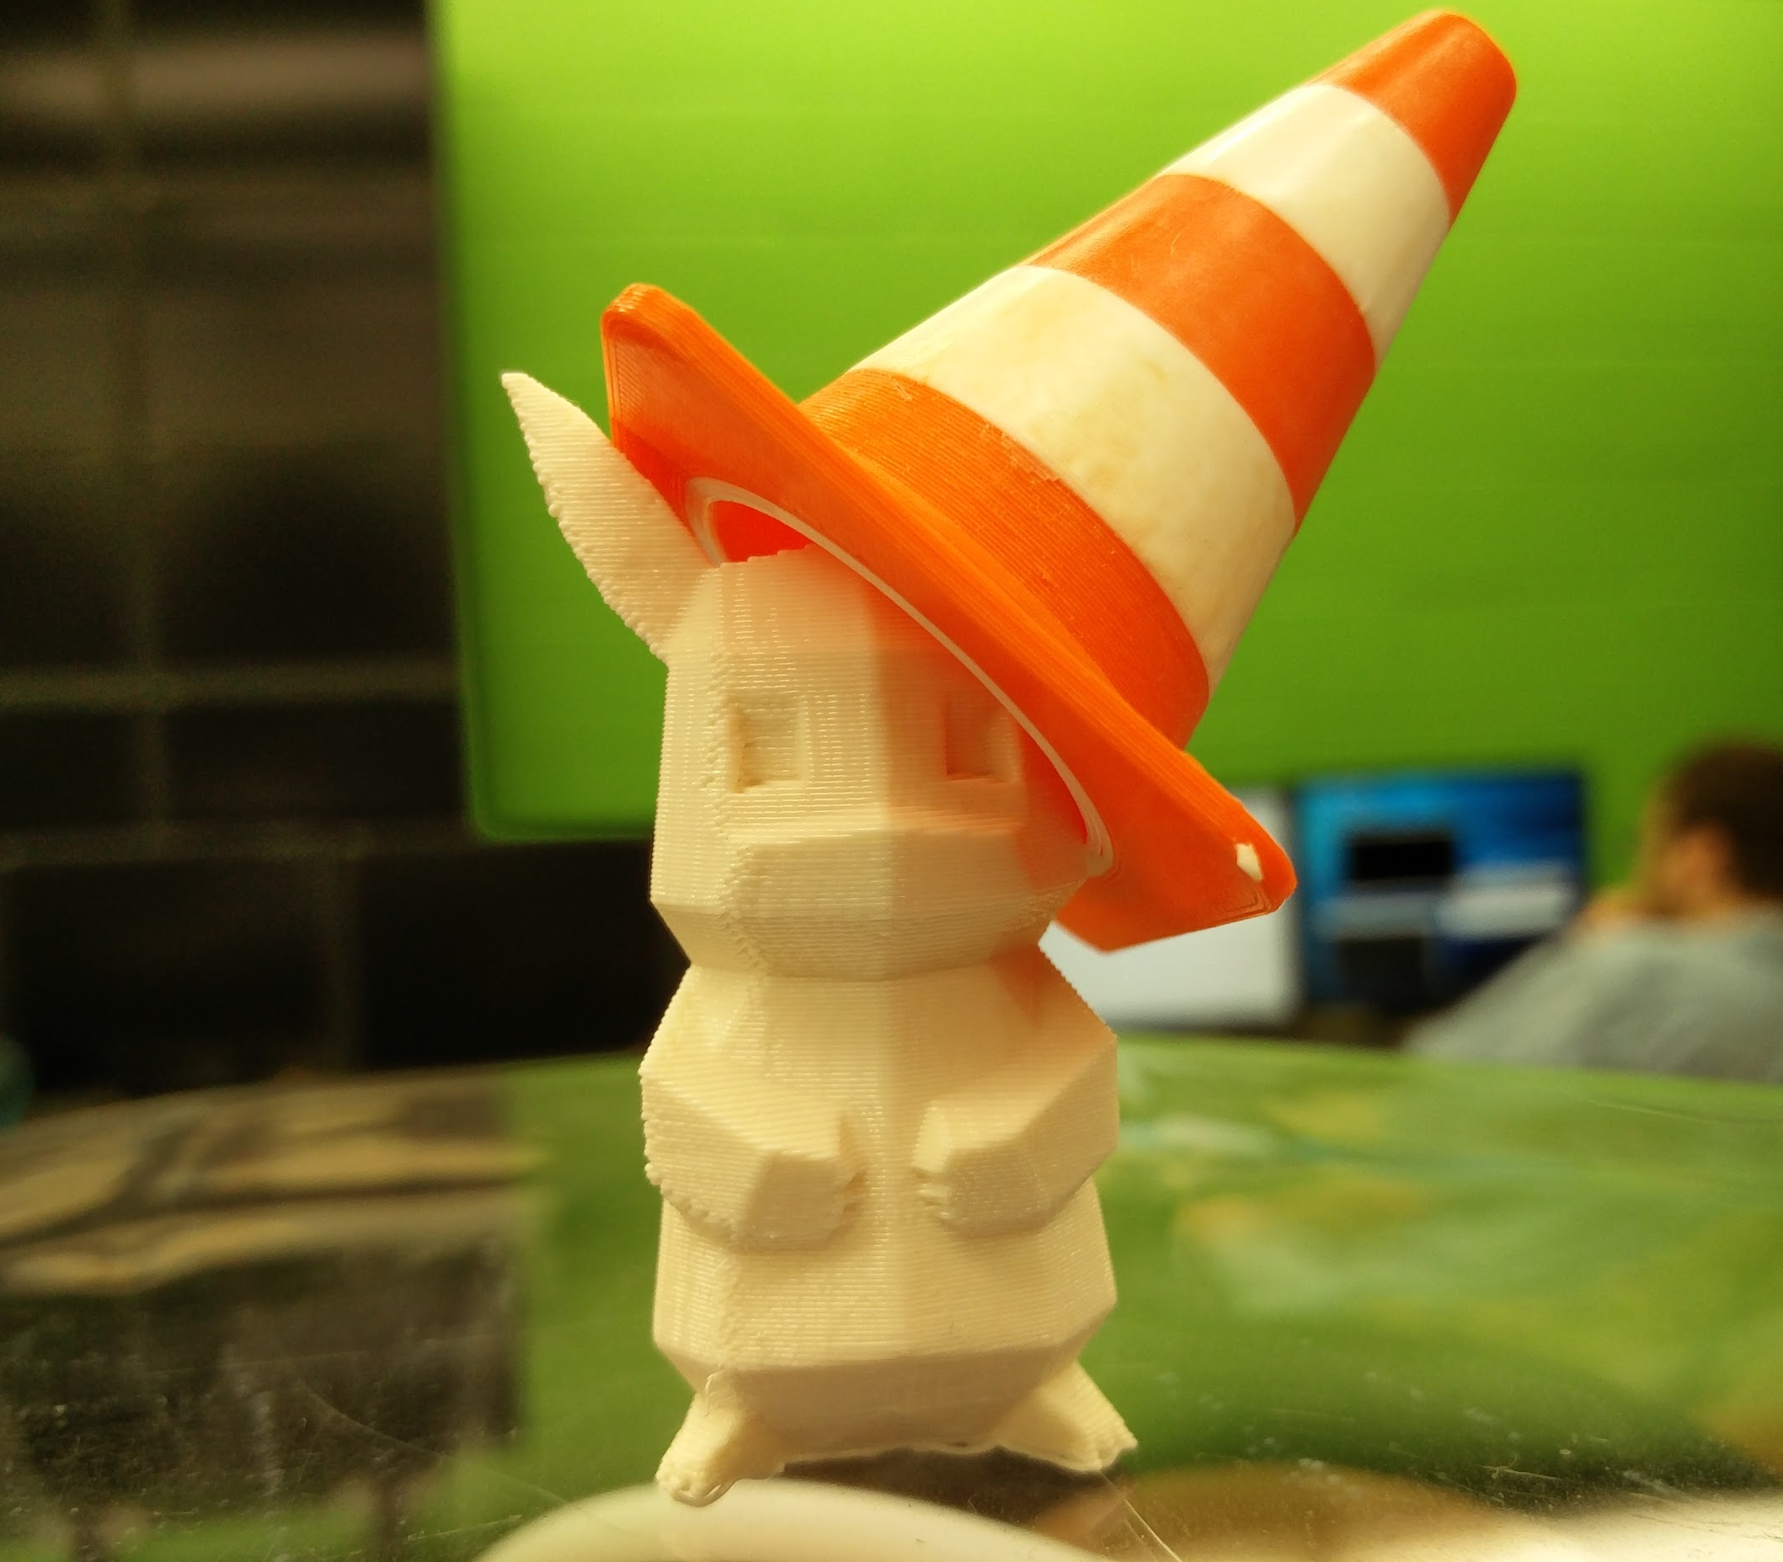

For individuals interested in
Linux, Unix, and their byproducts.
We are also in the ACM office (SEL 2264).
Resources:
3D Printing (10 cents/gram)
Arduino
Raspberry Pi
Test Servers
Tiled Displays
Linux Machines
Sign up for our listserv at! E-mail listserv@uic.edu
with the body “SUBSCRIBE LUG”
Officer E-mail: lug-uic-officers@googlegroups.com
Linux Users Group
Upcoming Events
Newbie Week
9/6, 9/7, 9/9, 9/12, 9/13 5-6 PM
SEL 2254
Install Fest
9/14 5-7 PM
SEL 2254

Slide 2
Welcome to NEWBIE Week
Welcome everyone to the first Linux User’s Group event of the year.
This is mostly going to be geared towards students who want to use Linux, but do not know how.
There will be more events during the year geared towards more advanced users of Linux as well.
After NEWBIE week, we will be holding an event called install fest. This will give opportunities to students to install LINUX as a dualboot or however they would like. We will have many different distros to choose from.

Slide 3
Possible LUG Events
Command of the Week
Go over a new linux command every week.
A bit more easygoing.
Linux From Scratch
Create a linux kernel from scratch.
Exciting, but be prepared to be challenged.
Debugging Competition
Debug common linux problems. There will be varying levels of difficulty.

Slide 4
LUG Install Fest
Held September 14th from 5 - 7 PM
We will help you install linux on your personal machines!
There will be a wide variety of linux distros to choose from.
Mint
Arch
Ubuntu
Fedora (Does not boot UEFI)
CentOS
OpenSUSE
Debian

Slide 5

GDB and Git
Michael Baccia

Slide 6

Who am I?
Vice President of LUG
Final year at UIC! ;(
Interest in Security
Shameless plug for my SIG

Slide 7
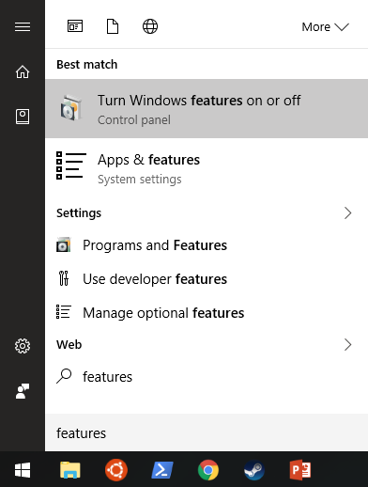
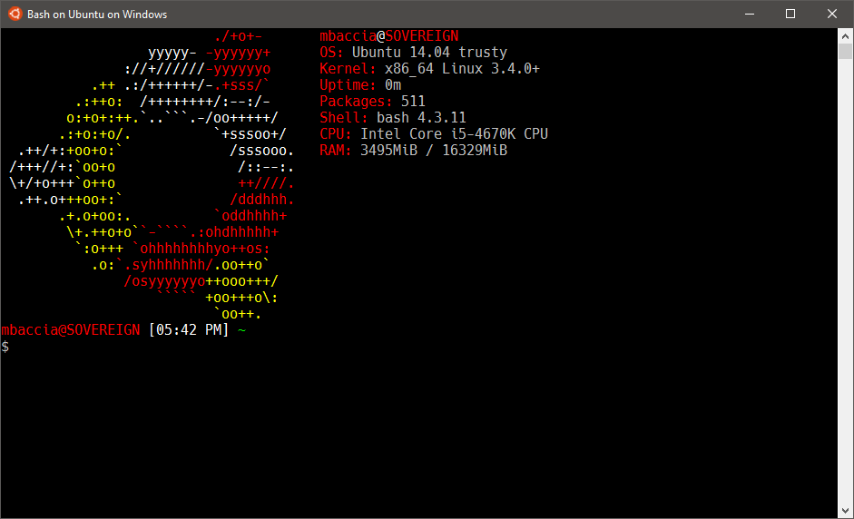
No Linux? No problem!
Windows 10 recently added Bash for Windows with the Anniversary update!
Enable in control panel under Programs and Features -> Turn features on or off:

Slide 8
What is Git?
Git is a free and open source distributed version control system
Manage the content of a project
Ease workflow and collaboration

Slide 9

Git != Github
!=

Slide 10
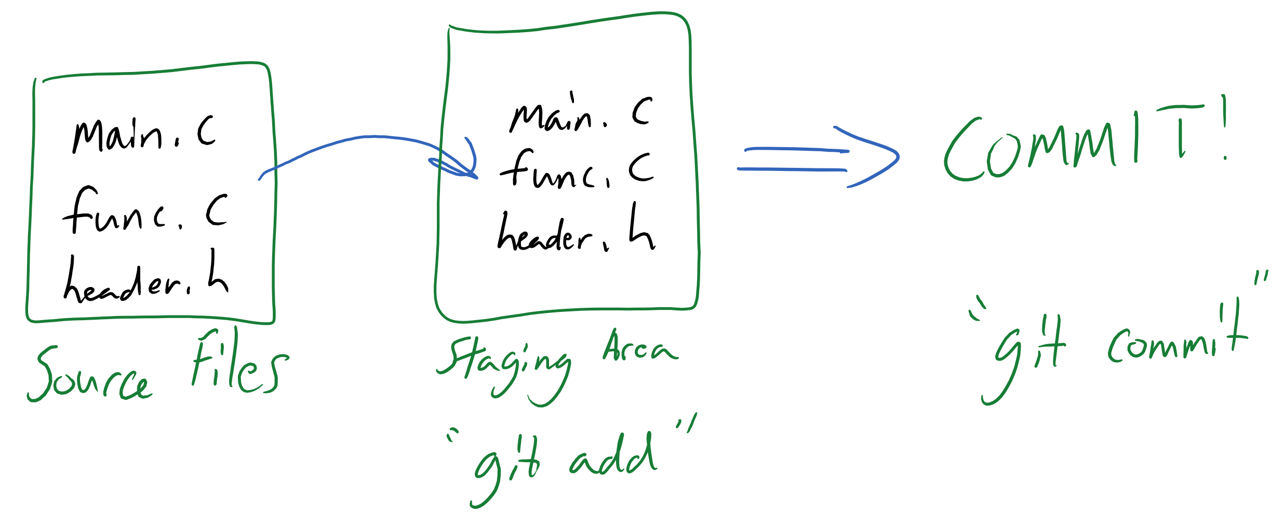
How does Git work?

Slide 11
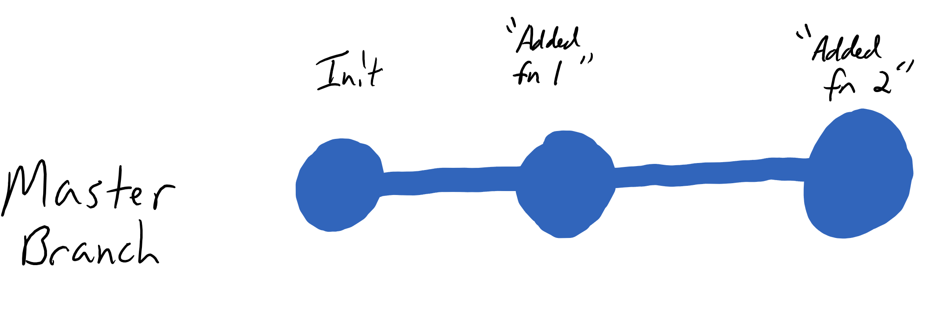
Workflow

Slide 12
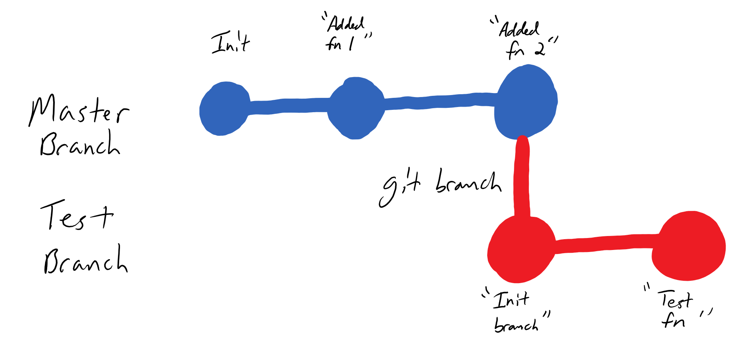
Collaboration!

Slide 13
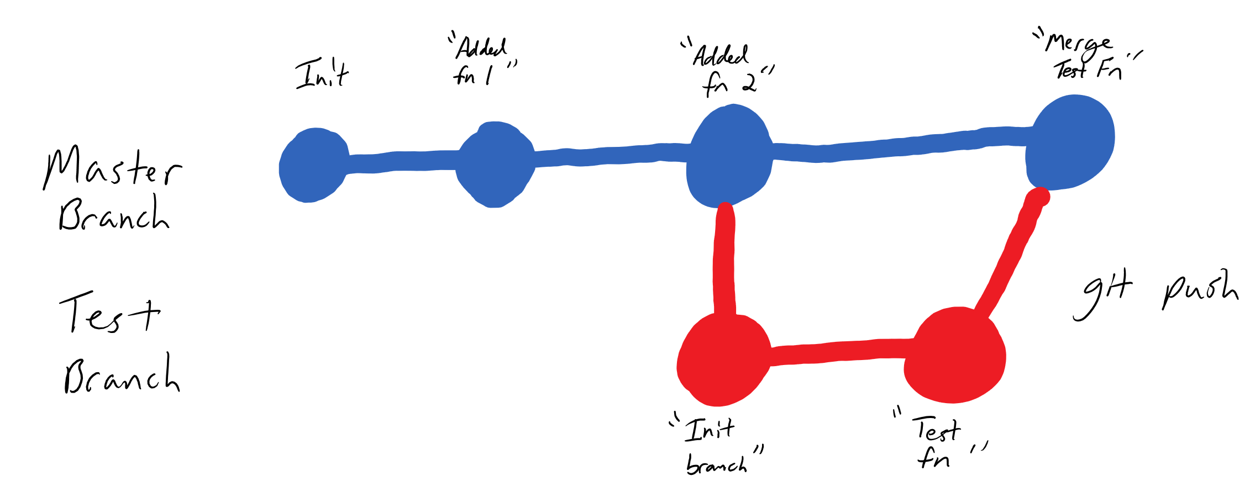
Merging with Master

Slide 14
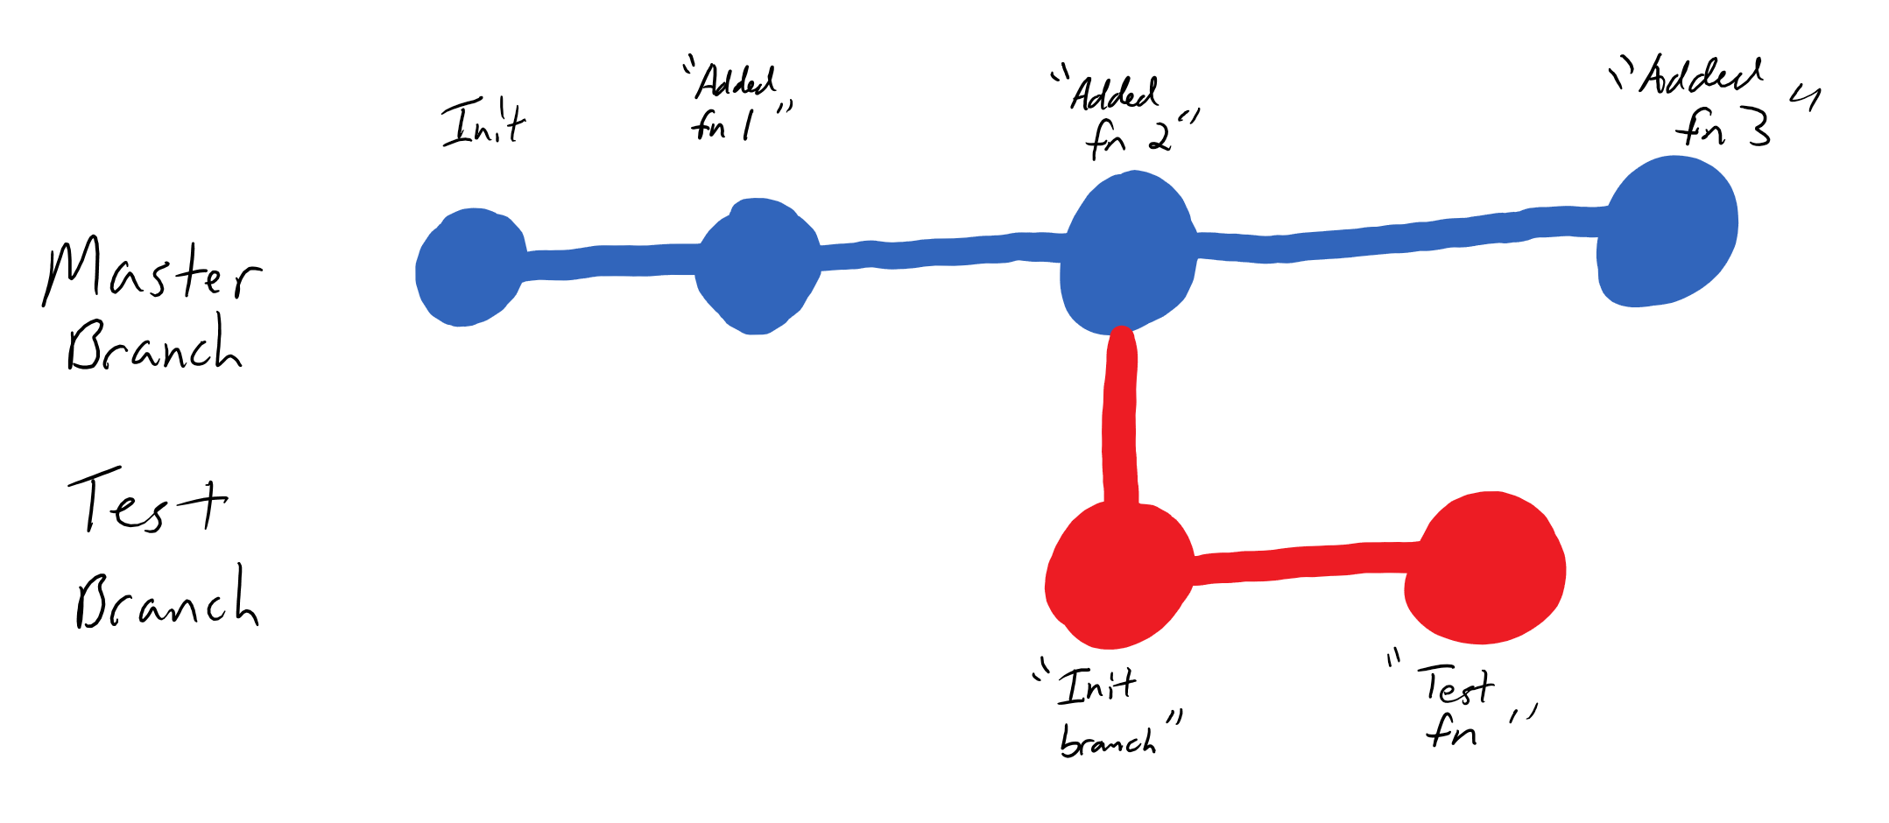
What if Master is ahead?

Slide 15
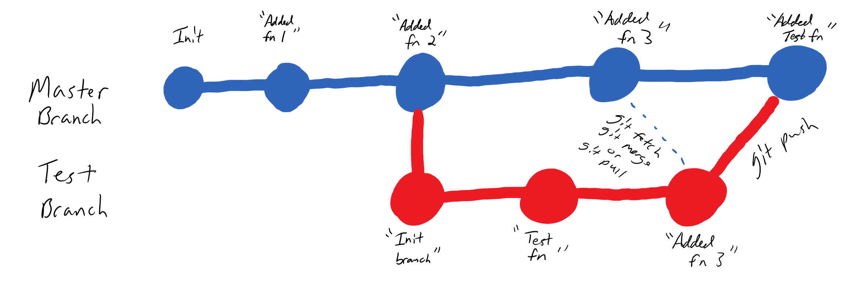
Merge then push!

Slide 16
git config
Git needs to know who to associate with your commits!
git config --global user.name “Michael Baccia”
git config --global user.email “mbacci3@uic.edu”

Slide 17
Basic Commands
git init
Initialize an empty repository
git status
shows what’s currently in the staging area
git log
shows commit history
git add <filenames>
add files to the staging area
can use * to add all files
will ignore files in your .gitignore file
git commit [-m “message”]
commit what’s currently in the staging area
git reset [--soft | --mixed | --hard]
resets to a prior commit

Slide 18
Remote Repo Commands
git clone < remote repository >
Creates a local copy of the given repository
git fetch [ repository ] [ branch ]
Grabs new remote branches and tags WITHOUT merging
git merge [ remote ] [ branch ]
Merge the remote tracked branch into the local branch
git pull [ remote ] [ branch ]
Performs a git fetch followed by a git merge
git push [ remote ] [ branch ]
Pushes local commits to the remote repository

Slide 19
Git Demo!

Slide 20
What is GDB?
GNU Project DeBugger
Multi-Platform debugger for C, C++, Objective-C and others.
Command-line interface
Many debugger act as a graphical interface to GDB, while others can interface with it!
Xcode debugger (front-end)
Eclipse, Netbeans, Qt Creator, Visual Studio (interface)

Slide 21
#1 Takeaway
For more help on a command, use the help command!
help <command>
Read the manual!!!

Slide 22
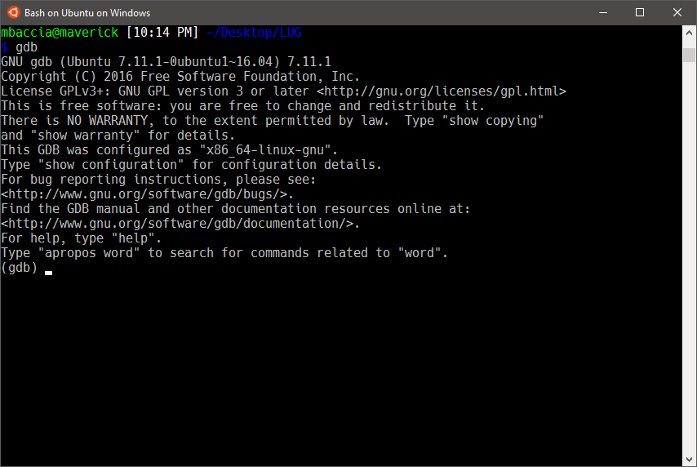
Interface

Slide 23
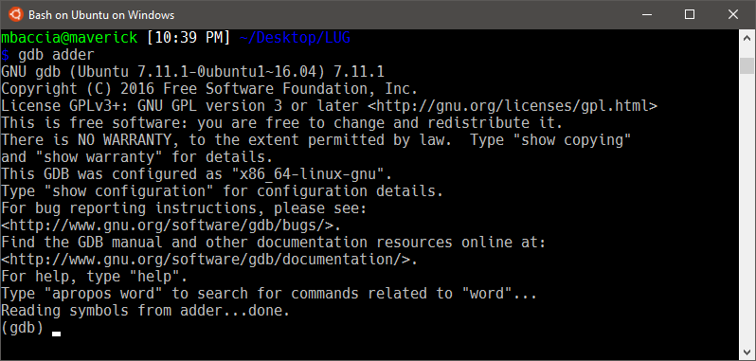
Basic Commands
Load a binary into gdb:
gdb [binary]
Tip:
Compile with gcc using the –g flag to generate debugging symbols!

Slide 24
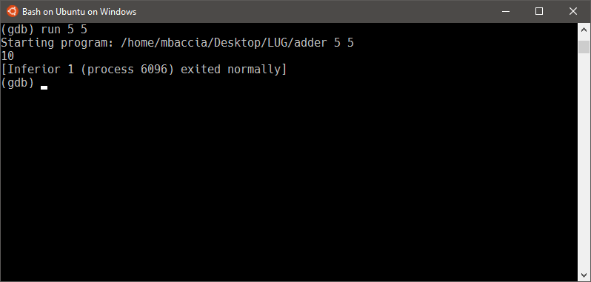
Basic Commands
run [param1 ] […param n]
begin execution of program with optional arguments.
Tip:
Use Ctrl + L to refresh your screen!

Slide 25
Flow Control
break <location>
Creates a breakpoint in the program, halting when execution reaches <location>.
The breakpoint can be specified in a couple of formats
By function name (ex. break main)
By source code line (ex. break 15)
Break is actually more flexible than this, see the help for more information.

Slide 26
Flow Control
clear <location>
Clears a previously set breakpoint
continue
Resumes execution after a breakpoint

Slide 27
Flow Control
step [n]
Step through n (default 1) lines in the source code.
Note: step will step into any embedded functions
Example: foo(bar(var));
next [n]
Similar to step, but will not step into embedded functions.

Slide 28
Printing
list <location>
Lists lines (default 10) of source code starting at location.
Use set listsize to change the default.
Location is specified similar to break.
disassemble [location]
Lists assembly instructions focused around location (or current execution line if none specified).
info <command>
Many subcommands available, although most used one will probably be reg (info registers).
p <expression>
Prints the value of the expression.
p buf (print the value of buf)
p &buf (print the address of buf)

Slide 29
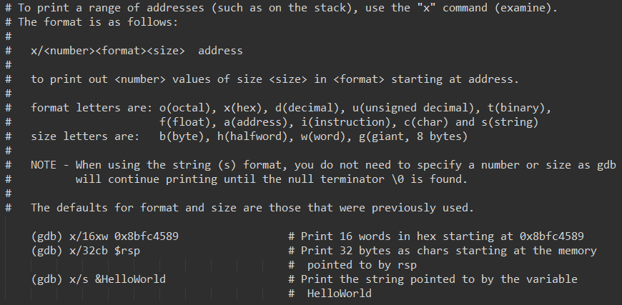
Printing
x/<format> <address>
Print out value in the specified format at address.

Slide 30
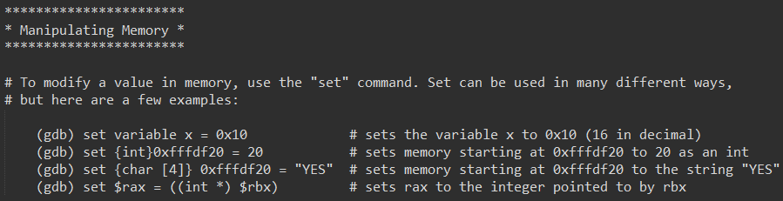
Manipulating Memory
set
Sets a variable, address, register etc. to the specified value
Can look a little messy

Slide 31
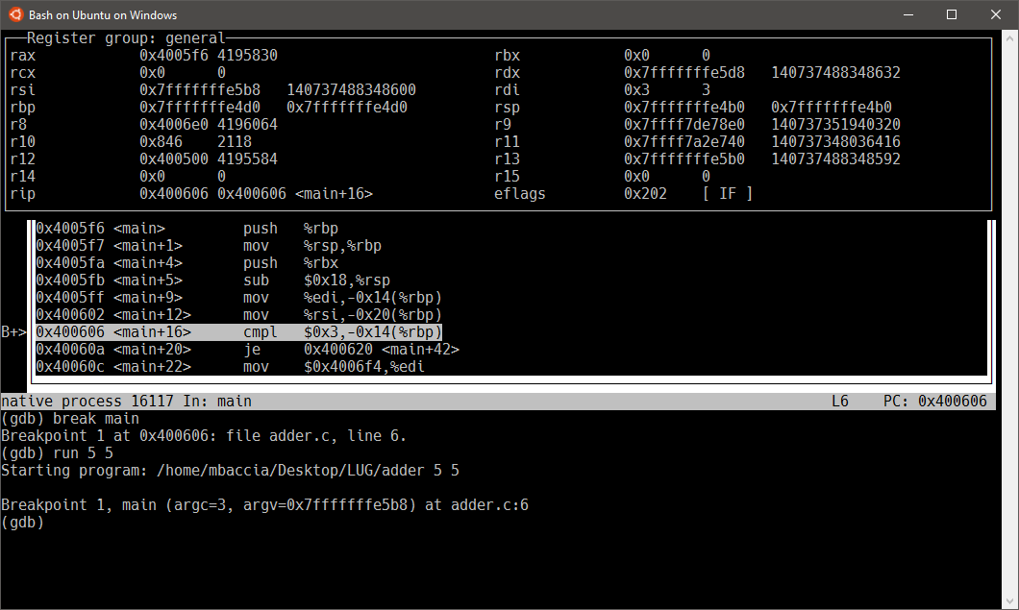
Layouts
layout <asm | regs | src | split>
Displays assembly, registers, source code or a combination of them!
focus <asm | regs | src | cmd | next | prev>
Change focus to specified pane.
Tip:
Use ‘Ctrl + x’ followed by ‘a’ to return to the normal interface.

Slide 32
GDB Demo!

